Slide 1
Publishing options:
Spanish institutions (CRUE) associated corresponding authors

Slide 2
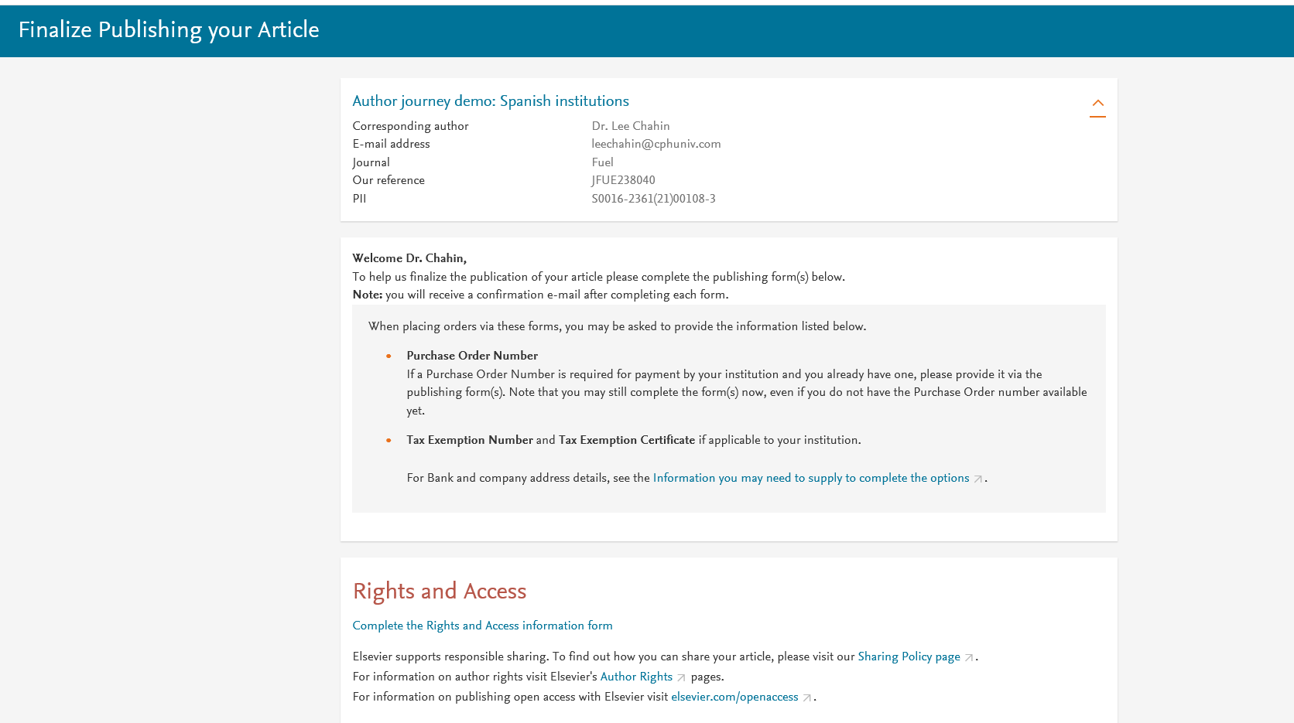
Corresponding author receives an email post acceptance with a unique link to complete the author journey and choose publishing options
Author clicks on Complete the Rights and Access information form

Slide 3
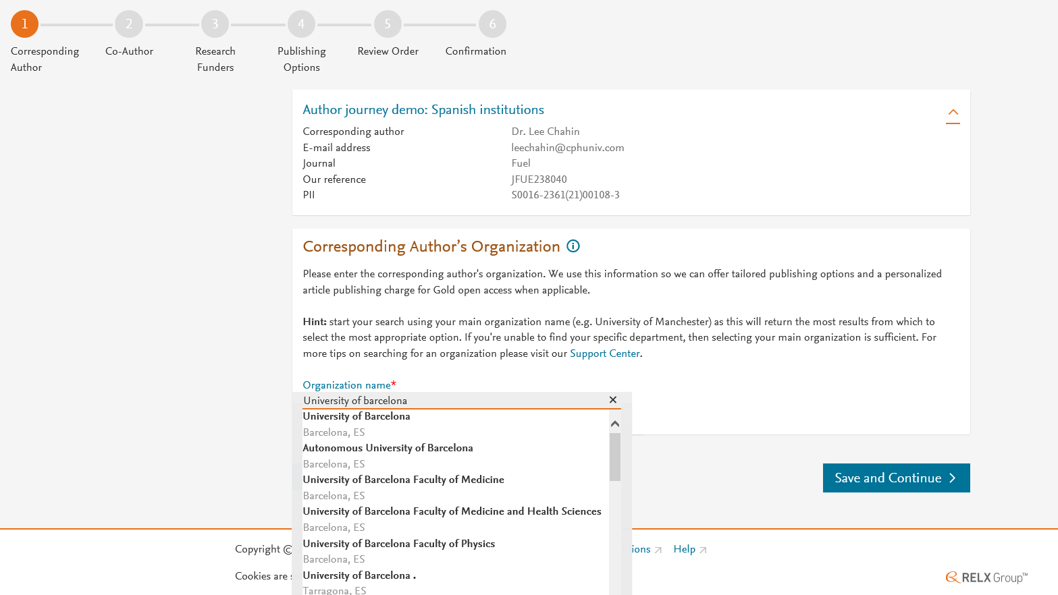
Corresponding author selects his/her affiliation details which we use to identify the authors and match them to the Spanish agreement

Slide 4
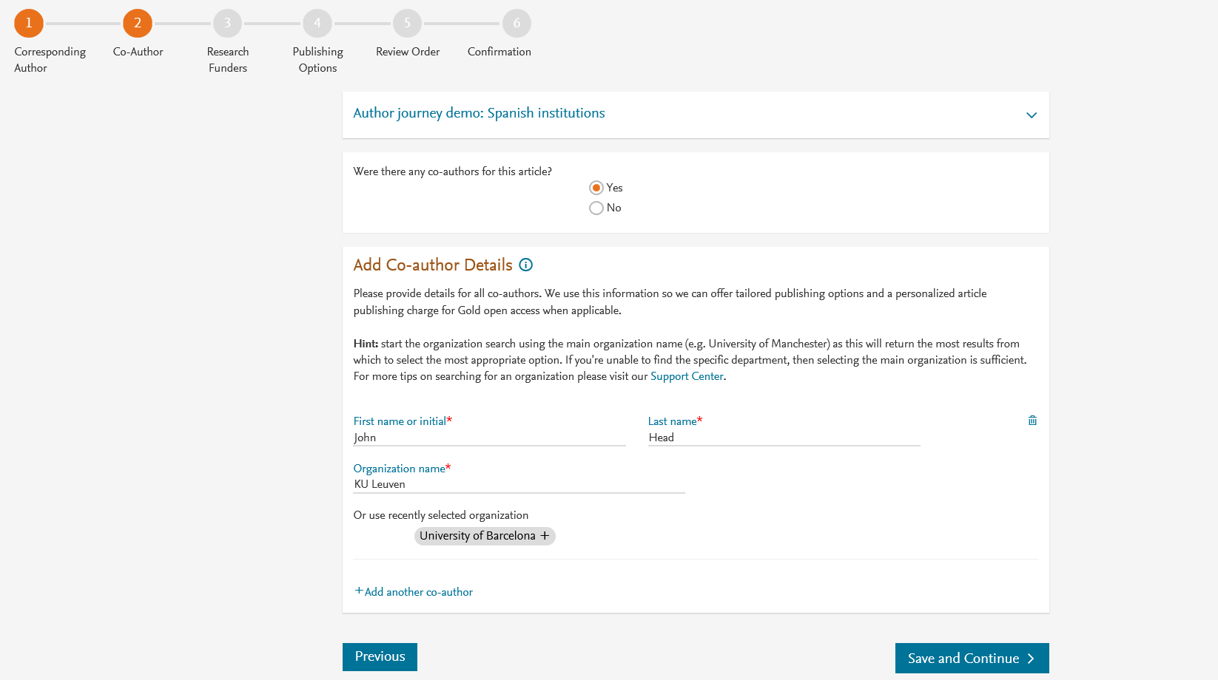
Corresponding author also adds the co-author affiliation details

Slide 5
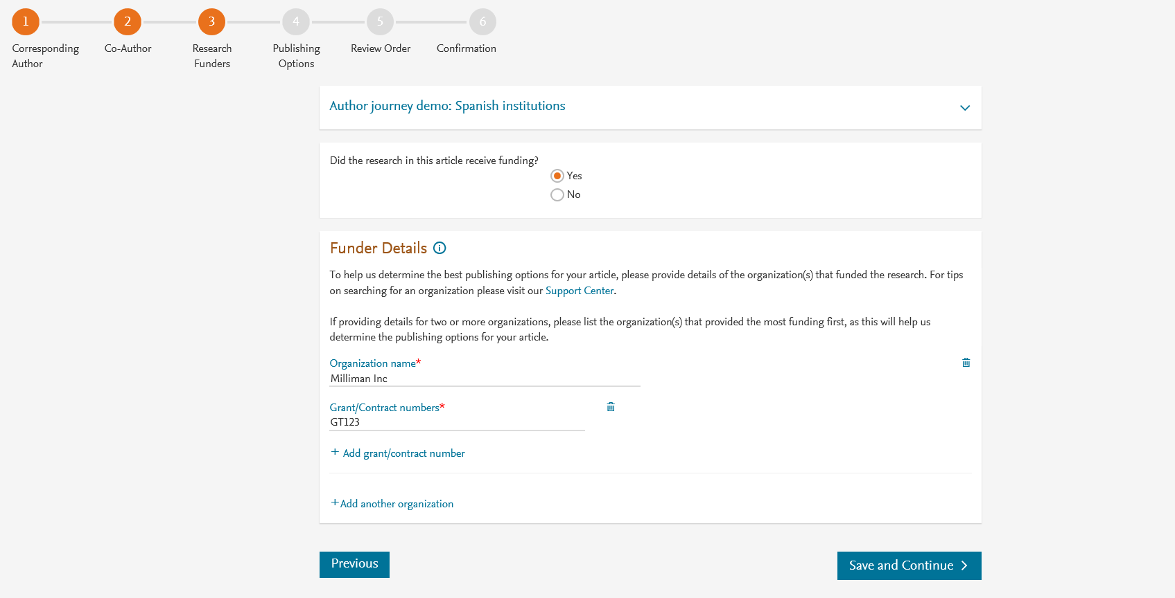
Author can add the Funder details. Funder can be the affiliated institute or a different one. In this case it is Milliman

Slide 6
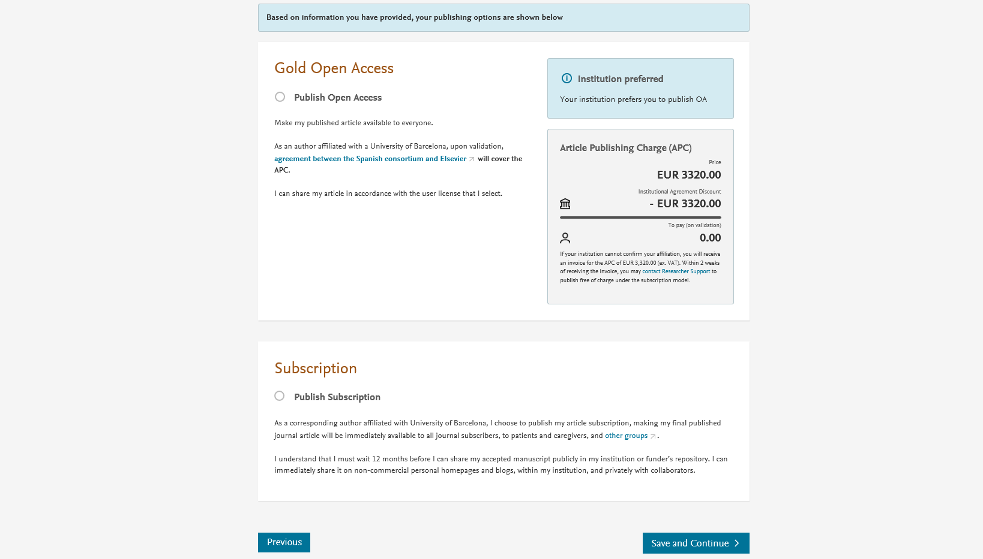
Personalized publishing options for the Spanish agreement

Slide 7
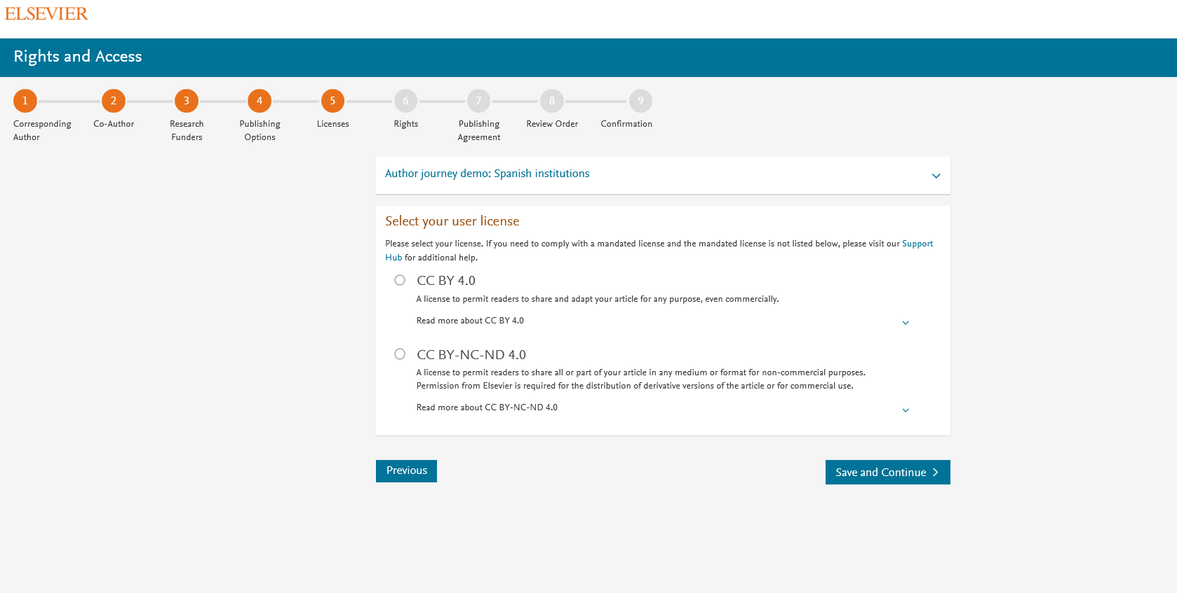
Elsevier offers two CC licenses for OA
Author selects the CC License

Slide 8
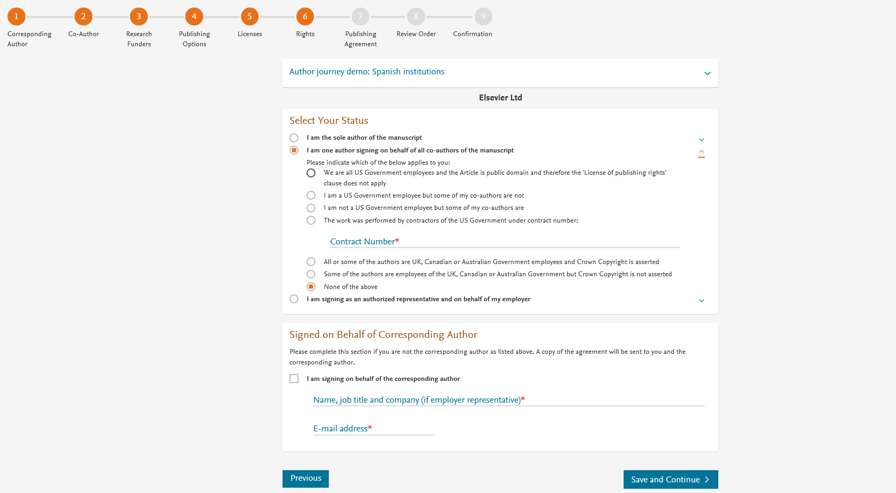
Author selects the rights

Slide 9
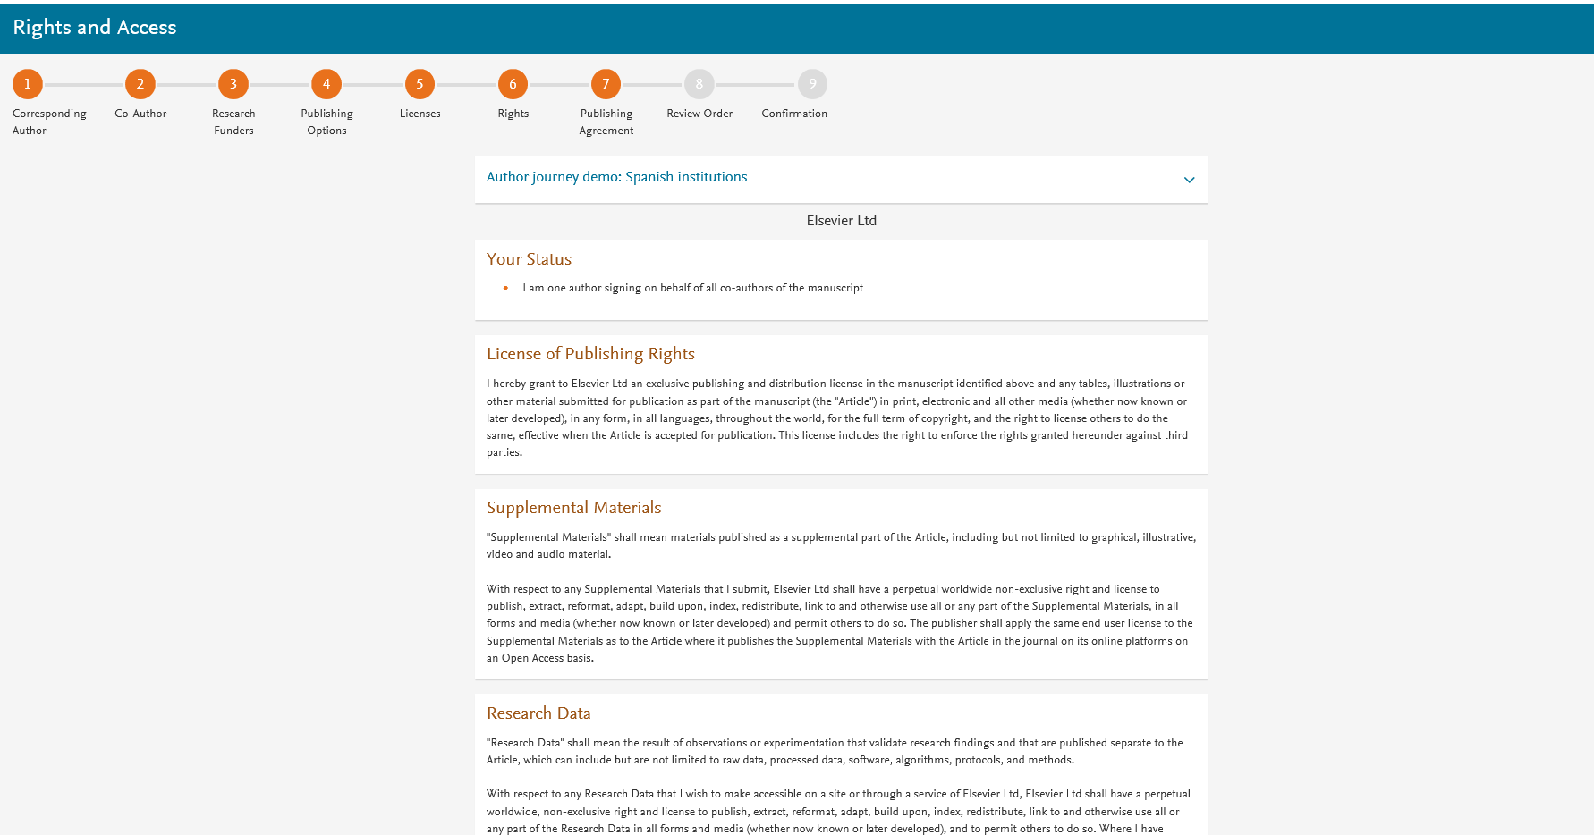
System presents author with the Journal License Publishing Agreement

Slide 10
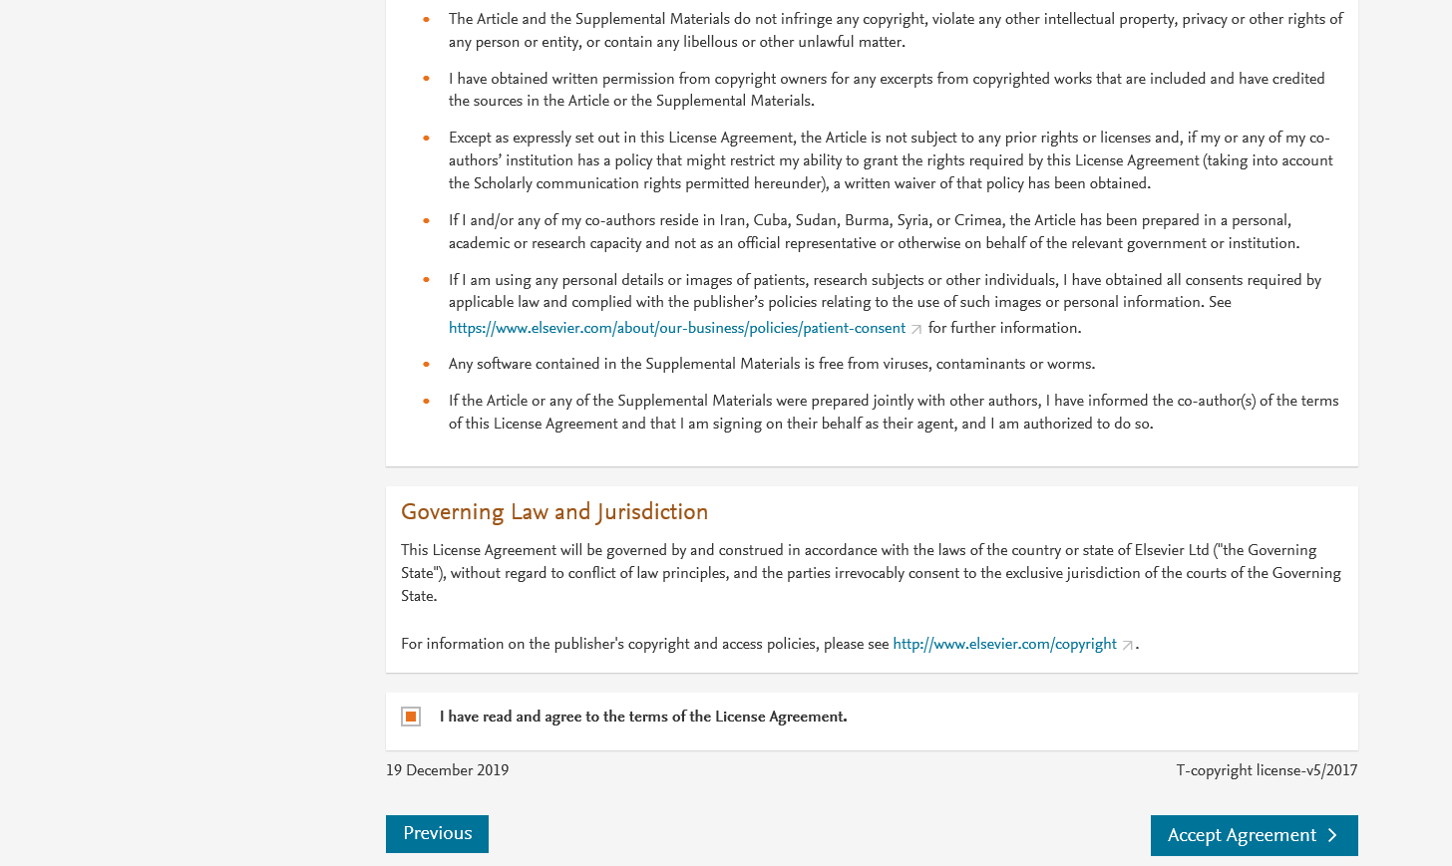
Authors agrees to the Journal License Publishing Agreement

Slide 11
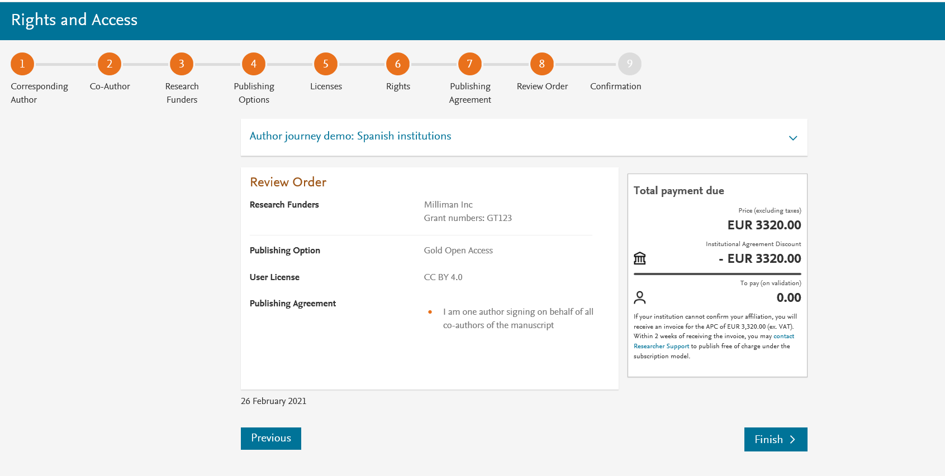
This is the summary page explaining the choices the author made in the publishing journey
Corresponding author and coauthors receive a copy of summary via email
Articles becomes OA on Science Direct within 24 hours
Librarian at the institute will receive a notification for validation within 48 hours who then has 3 weeks to complete the validation

Slide 12
Support for authors and librarians
Author queries – support@elsevier.com
Librarian queries, EOAP account set up or changes – agreementactivation@elsevier.com
Author journey videos: https://service.elsevier.com/app/answers/detail/a_id/29789/supporthub/publishing/track/APN2ZgoIDv8a~RNiGvwa~yKgpv0qOS75Mv9e~zj~PP_X/

